Slide 1
Evolutionary Learning

Slide 2
Evolutionary Computation
A collection of computational methods inspired by
biological evolution:
A population of candidate solutions evolves over time, with the fittest at each generation contributing the most offspring to the next generation
Offspring are produced via crossover between parents, along with random mutations and other “genetic” operations.

Slide 3
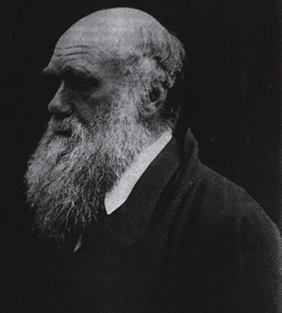
Evolution made simple
Essentials of Darwinian evolution:
Organisms reproduce in proportion to their fitness in the environment
Offspring inherit traits from parents
Traits are inherited with some variation, via mutation and sexual recombination
Charles Darwin
1809–1882

Slide 4
Evolution made simple
Essentials of evolutionary algorithms:
Computer “organisms” (e.g., programs) reproduce in proportion to their fitness in the environment (e.g., how well they perform a desired task)
Offspring inherit traits from their parents
Traits are inherited, with some variation, via mutation and “sexual recombination”
Essentials of Darwinian evolution:
Organisms reproduce in proportion to their fitness in the environment
Offspring inherit traits from parents
Traits are inherited with some variation, via mutation and sexual recombination

Slide 5
Appeal of ideas from evolution:
Successful method of searching large spaces for good solutions (chromosomes / organisms)
Massive parallelism
Adaptation to environments, change
Emergent complexity from simple rules

Slide 6
Evolution
Survival of the fittest
Live longer (more chance to reproduce)
More attractive (more chance to reproduce)
Higher number of offspring (more survive)
50% chance of any gene being in offspring

Slide 7
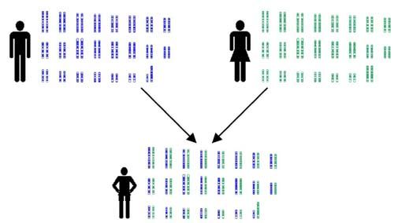
Evolution

Slide 8
Punctuated Equilibrium
Fitness
Equilibria
Generation

Slide 9
Fitness Landscapes
Useful imagination aid
Animals' fitness is partly due to competition with other animals and environment
Changes over time
Evolution favors animals that evolve to peaks of the fitness landscape

Slide 10
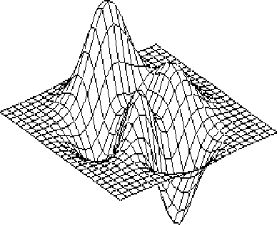
Fitness Landscapes

Slide 11
The Genetic Algorithm (GA)
How can we abstract the useful bits of evolution?
How can we fit them into an algorithm?
Does it work?

Slide 12
Representation: Strings and Things
Work out a way of encoding problem
Choose an alphabet
Possible values of each element of string
Often binary
Not always easy
Split up the problem into discrete parts

Slide 13
Representation: Strings and Things
Example: bill paying
List of 100 bills to pay
Use string of 100 elements
Each element is whether to pay one bill
10110 means pay bills 1, 3, and 4

Slide 14
Fitness Functions
Decide how good the string is
You pass in a string and get back a number
The higher the number, the better the solution
Generally a positive number
Problem-specific part

Slide 15
Selection
Choosing parents is crucial
Want the best (fittest) strings to reproduce
Exploitation
What about non-fit strings?
Exploration
Generate a ‘mating pool’

Slide 16
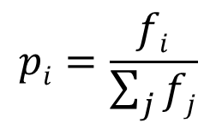
Selection
Fitness proportional selection
Pick proportional to fitness. A string A_{i} with fitness value 𝑓_{𝑖} is copied in the next generation with a probability:

Slide 17
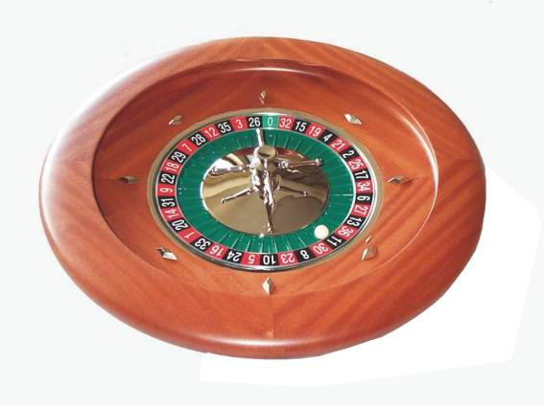
Selection
Like a roulette wheel
Probability of picking a string is proportional to its area on wheel
Fitter strings have a larger number of copies - larger area
X4
X1
X3
X2

Slide 18
Other Selection Methods
Truncation selection
Pick the top 50% of strings
Choose from them at random
Elitism
Keep a copy of the best strings all the time
Tournaments
Put the fittest 2 out of the parents and offspring into the new population

Slide 19
Other Selection Methods
Niching (used in distributed computing)
Sometime exploration stops - premature convergence
Evolve several subpopulations and occasionally swap a few elements
Also called island populations

Slide 20
Genetic Operators
How do we combine the two parents?
1 0 0 1 1 0 0 0 1 0 1
0 1 1 1 1 0 1 0 1 1 0

Slide 21
Genetic Operators
Single Point Crossover
1 0 0 1 1 0 0 0 1 0 1
0 1 1 1 1 0 1 0 1 1 0
1 0 0 1 1 0 1 0 1 1 0

Slide 22
Genetic Operators
Mutation
1 0 1 1 1 0 1 0 1 1 1
1 0 1 1 0 0 1 0 1 1 1

Slide 23
Synergy – the KEY
Clearly, selection alone is no good …
Clearly, mutation alone is no good …
Clearly, crossover alone is no good …
Fortunately, using all three simultaneously is sometimes spectacular!

Slide 24
Typical GA Operation -- Overview
Initialize population at random
Evaluate fitness of new chromosomes
Good
Enough?
Yes
Done
No
Select survivors (parents) based on fitness
Perform crossover and mutation on parents

Slide 25
A Simple Genetic Algorithm
1. Start out with a randomly generated population of chromosomes (candidate solutions).
2. Calculate the fitness of each chromosome in the population.
3. Select pairs of parents with probability a function of fitness rank in the population.
4. Create new population: Cross over parents, mutate offspring, place in new population.
5. Go to step 2.

Slide 26
Premature Convergence
Fitter members of population are favored
Solutions at local maxima are favored
Exploitation, not exploration
Selection for the local maximum
Diversity in population reduces
Already seen niching
Can also average fitness across number of identical strings (fitness sharing)

Slide 27
Guaranteed Convergence?
Not much successful analysis
Not guaranteed to converge at all
Not guaranteed to reach global maximum
Can be very slow
Trade-off between the genetic operators

Slide 28
Neural Networks and Genetic Algorithms
Multi-Layer Perceptron
Computed error at each neuron
Computed gradient
Could use GA instead of gradient descent
Throw away gradient information
Replace all errors by 1 fitness

Slide 29
Neural Networks and Genetic Algorithms
More sensible: use GA to select the network structure
Mutation only - crossover not sensible
Several mutations:
Add a node
Delete a node
Add a weight connection
Delete a weight connection
Use normal training

Slide 30
Genetic Algorithms in Practice: Optimization of A Function

Slide 31
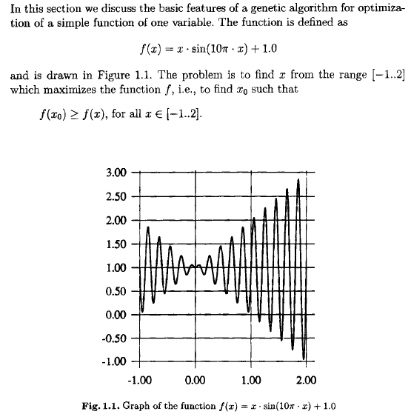
How can we approximate the max it using a GA?
Mathematically, we also can obtain the max: f(1.85) = 2.85

Slide 32
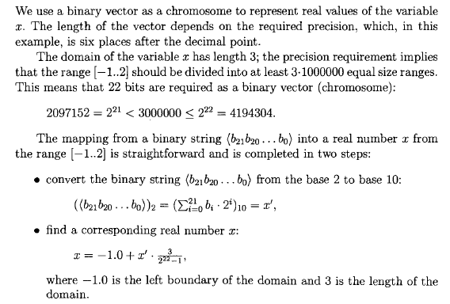
Representation

Slide 33
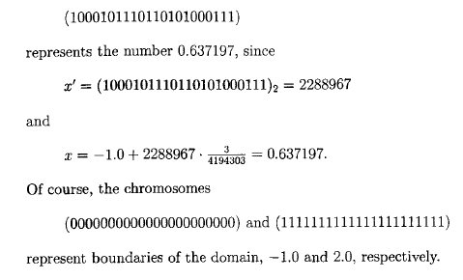
Representation: Example

Slide 34

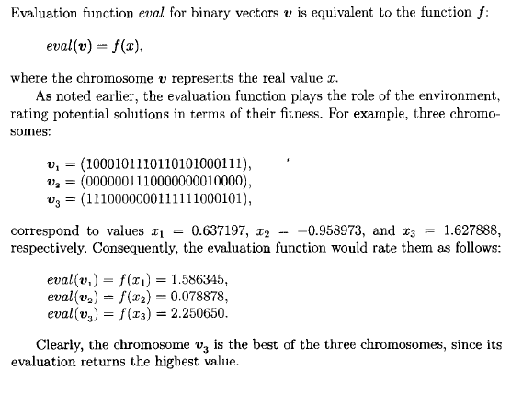
Initial Population and Evaluation (Fitness) Function

Slide 35
Selection
Fitness proportional selection: Pick proportional to fitness (roulette wheel).
A string A_{i} with fitness value 𝑓_{𝑖} is copied in the next generation with a probability:
$$pi=\frac{fi}{\sum_{j}{fj}}$$

Slide 36
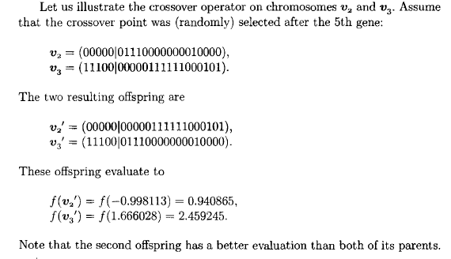
Crossover

Slide 37
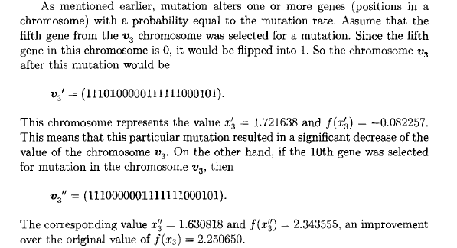
Mutation

Slide 38
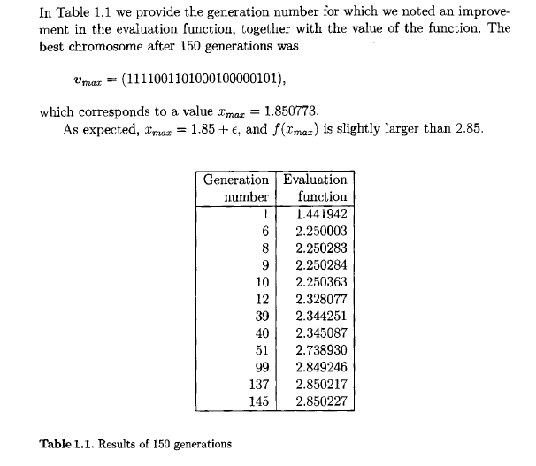
Experimental Results (Population Size = 50)

Slide 39
Genetic Algorithms in Practice: Coloring A Map

Slide 40
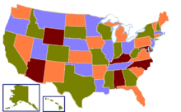
The Four Color Map Theorem
A four-coloring of a map
of the states of the USA
Given any separation of a plane into contiguous regions, producing a figure called a map, no more than four colors are required to color the regions of the map so that no two adjacent regions have the same color (adjacent means that two regions share a common boundary curve segment, not merely a corner where three or more regions meet).
The four-color theorem was proved in 1976 by Kenneth Appel and Wolfgang Haken. It was the first major theorem to be proved using a computer.

Slide 41
Our Problem
Color the map with any of three colors
No two bordering countries can have the same color

Slide 42
Making a GA for 3-Coloring
Represent possible solutions as strings of symbols
RGGBRBGGBRBRB

Slide 43
Making a GA for 3-Coloring
Devise a fitness function
Fitness increases for better solutions
f = number of boundaries that are OK
16 out of 26 in this example

Slide 44
Making a GA for 3-Coloring
Make a population of solutions
Apply genetic operators to them to make a new population
Iterate
[R G B B …] [G G G R …] [R G R B …]
[G B R R …] [B G R B …] [G B R G …]

Slide 45
Making a GA for 3-Coloring
Generate a new population from the old one
Bias the selection to pick the fitter strings more often

Slide 46
Making a GA for 3-Coloring
Mutation
Change randomly selected bit to another colour with small probability

Slide 47
Making a GA for 3-Coloring
+
Crossover
Combine pairs of strings to form new strings

Slide 48
Making a GA for 3-Coloring
+
RGBRRBGRBGBRB
BGGGBRGBRGBG
RGBRRBGRBGBRB
BGGGBRGBRGBG
RGBGBRGBRGBG

Slide 49
Making a GA for 3-Coloring
+

Slide 50
Genetic Programming
One of the central challenges of computer science is to get a computer to do what needs to be done, without telling it how to do it.
Genetic programming addresses this challenge by providing a method for automatically creating a working computer program from a high-level problem statement of the problem.
Genetic programming genetically breeds a population of computer programs to solve a problem.

Slide 51

Represent computer programs as trees
Evolve the trees
Fitness is how well/quickly the program works
Used for many tasks
Skin melanoma detection
Chip design

Slide 52
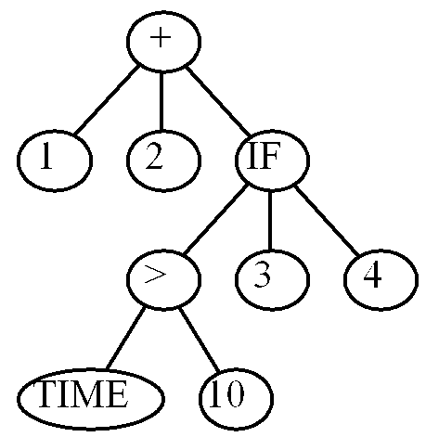
(+ 1 2 (IF (> TIME 10) 3 4))

Slide 53
Mutation
-
+
+
0
1
*
x
1
1
x
x
Generate a random subtree
Choose a subtree to replace

Slide 54
Mutation
-
+
0
x
1
+
1
*
x
x

Slide 55
Crossover
-
+
+
0
1
*
x
1
1
x
x
Choose a pair of subtrees to swap

Slide 56
Crossover
-
+
+
0
1
*
x
1
x
x
1

Slide 57
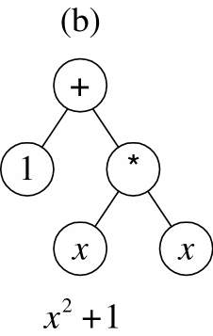
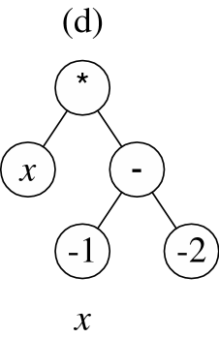
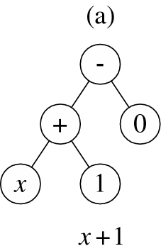
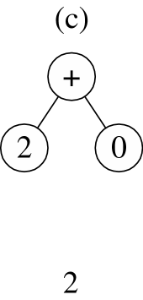
Genetic Programming
4 randomly chosen initial trees

Slide 58
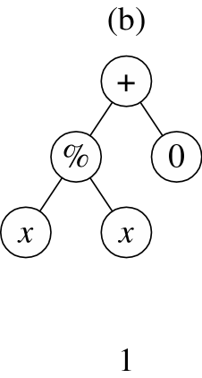
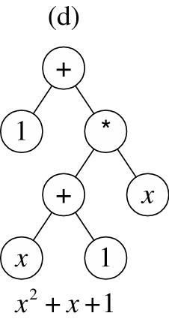
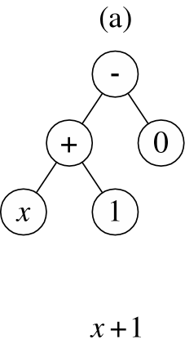
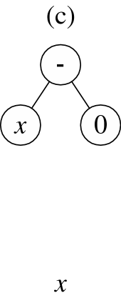
Genetic Programming
Mutation of (c) from the (2)
Crossover of (a) and (b)
Second crossover of (a) and (b)
Copy of (a)

Slide 59
Genetic Programming
Search space unbelievably large
Depends strongly on initial population
Programmer develops a set of possibly useful subtrees

Slide 60
Some real-world uses of genetic algorithms
Used by GE to automate parts of aircraft design
Used by pharmaceutical companies to discover new drugs
Used by the London Stock Exchange to automatically detect fraudulent trades
Used by US government agencies to automatically analyze satellite images
Used for automatic analysis of medical images
Used to create art (displayed in well-known museums)
Used to generate realistic computer animation in the movies Lord of the Rings: The Return of the King and Troy
Used to model and understand evolution in nature!

Slide 61
Libraries
DEAP is a Python evolutionary computation library for rapid prototyping and testing of ideas
ECJ 20: A Java Based Evolutionary Computation and Genetic Programming Research System

Slide 62
When Might a GA Be Any Good?
Highly multimodal functions
Discrete or discontinuous functions
High-dimensionality functions, including many combinatorial ones
Nonlinear dependencies on parameters (interactions among parameters) -- “epistasis” makes it hard for others
Often used for approximating solutions to NP-complete combinatorial problems
DON’T USE if a hill-climber, etc., will work well

Slide 63
The Limits to Search
No search method is best for all problems – per the No Free Lunch Theorem
Don’t let anyone tell you a GA (or THEIR favorite method) is best for all problems!!!
Needle-in-a-haystack is just hard, in practice
Efficient search must be able to EXPLOIT correlations in the search space, or it’s no better than random search or enumeration
Must balance with EXPLORATION, so don’t just find nearest local optimum

Slide 64
My own GA Applications
Lemley, J., Andonie, R., Odah, A., Heer, P., Widger, J., Erkul, B., Magill, L., Littlefield, K. CWU-Chess: An Adaptive Chess Program that Improves After Each Game, Proceedings of the IEEE Games, Entertainment, Media Conference (GEM), August 15-17, 2018, Galway, Ireland, 86-89
Andonie R., Fabry-Asztalos L., Abdul-Wahid B., Abdul-Wahid S., Barker B., Magill L. Fuzzy ARTMAP Prediction of Biological Activities for Potential HIV-1 Protease Inhibitors using A Small Molecular Dataset, IEEE/ACM Transactions on Computational Biology and Bioinformatics 8, 2011, 80-93

